Slide 1
JavaScript
Shallow copy vs. deep copy

Slide 2
what is a copy?
When you copy element to another
You expect the original element to stay the same, if you change in the copied element
=That’s doesn’t work completely in JavaScript
Let me introduce two types of variables in JavaScript:
Primitive data types: String, Number, Boolean, Undefined, Null, …
Composite data types: Objects and Arrays
When you copy variables of
primitive data types real copy happens
composite data types shallow or deep copy may happen

Slide 3
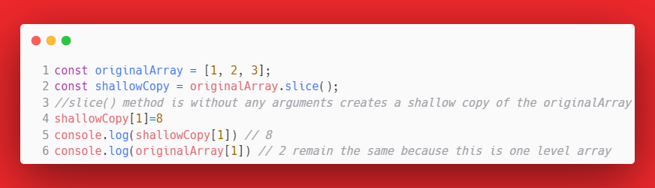
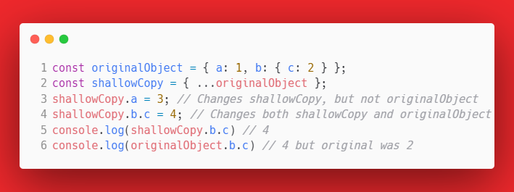
Shallow Copy: creates a new object or array and copies only the first level of the object. Deeper levels are referenced.
(the new copy points to the same memory locations as the original)
= modifying copy of the object will only affect deep levels of original object or array

Slide 4
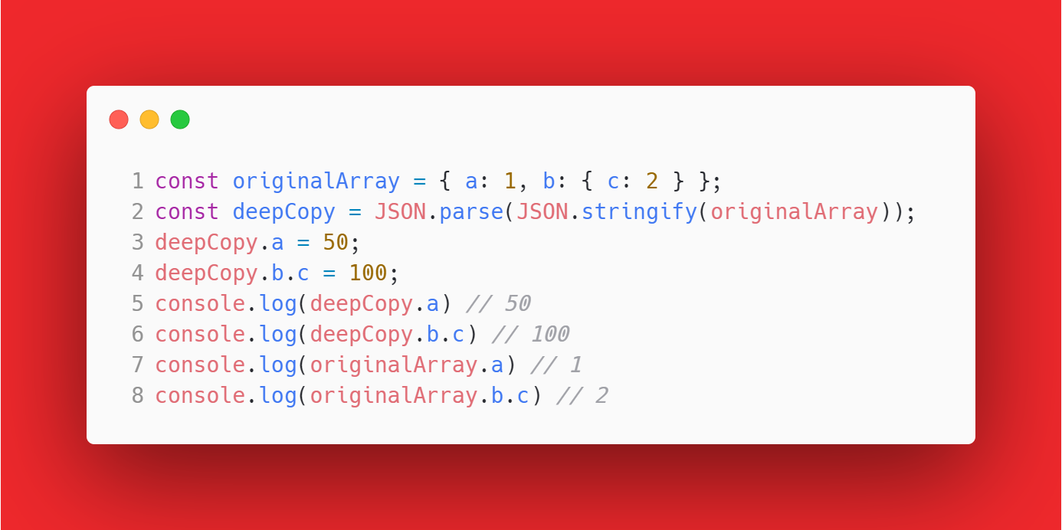
Deep Copy: creates a completely independent copy of the original object or array, including all nested elements (new copy has its own memory references and modifying it will not affect the original)
= modifying copy of the object will not affect the original object or array.\
There is many ways to do deep copy one of them is using JSON.stringfy to change array to string then using JSON.parse to

Slide 5
Take care that:
Shallow copy: means that only the first level of the object is copied. Deeper levels are referenced.
Deep copy: means that all levels of the object are copied. This is a true copy of the object.

Slide 6
Performance Considerations
Deep copying is more expensive in terms of performance than shallow copying.
because creating a new object and copying all of its properties and nested objects can take more time and memory than simply creating a new object with references to the same memory locations as the original object.
Use shallow copying if you need to make sure that changes to a copied object do not affect the original object, deep copying is necessary.

Slide 7
Thanks

